Slide 1
Exception Handling

Slide 2
Common Errors

Slide 3
Common Errors
NoClassDefFoundError
NoSuchMethodError: main
Cannot resolve symbol
Local variables must be initialized
ArrayIndexOutofBounds & NumberFormat exception

Slide 4
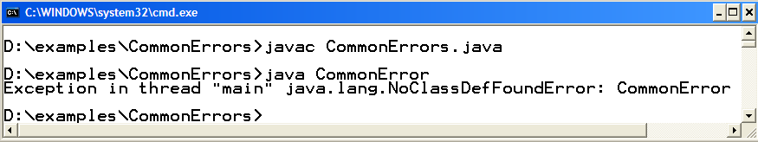
Error: Exception in thread “main”
NoClassDefFoundError
public class CommonErrors{
public static void main (String args[]) {
System.out.println(“Hello World”);
}
}

Slide 5
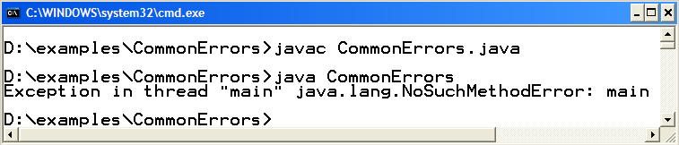
Error: Exception in thread “main”
NoSuchMethodError: main
public class CommonErrors{
public static void display () {
System.out.println(“hello world”);
}
}
public static void main (String args[]) {
CommonErrors.display();
}

Slide 6
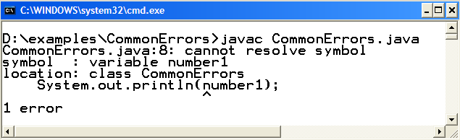
Error: cannot resolve symbol
public class CommonErrors{
public static void main (String args[]) {
int number;
System.out.println(number1);
}
}
number);

Slide 7
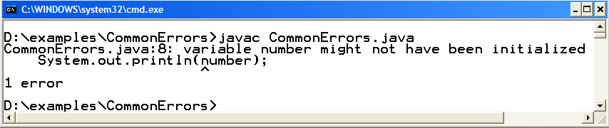
Error: Local variable not initialized
public class CommonErrors{
public static void main (String args[]) {
int number ;
System.out.println(number);
}
}
= 10 ;

Slide 8
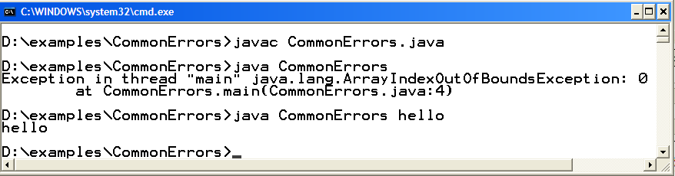
Error: ArrayIndexOutofBoundsException
public class CommonErrors{
public static void main (String args[]) {
System.out.println(args[0]);
}
}

Slide 9
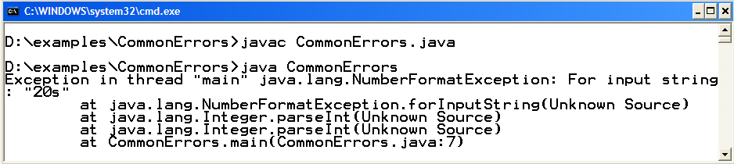
Error: NumberFormatException
public class CommonErrors{
public static void main (String args[]) {
String s = “20s”;
int number = Integer.parseInt(s);
}
}
= “20” ;

Slide 10
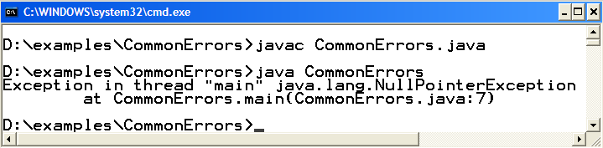
Error: NullPointerException
public class CommonErrors{
public static void main (String args[ ]) {
Student s = null;
s.print( );
}
}

Slide 11
Intro to Exceptions

Slide 12
Types of Programming Errors
Three types of error:
  Syntax Errors – arise because the rules of the language are not followed.
  Runtime Errors – arise because the program tries to perform an operation that is impossible to carry out.
  Logic Errors – arise because the program does perform the way it was intended to.
Syntax errors are caught by the compiler, and fixed before the program is run.
Logic Errors are detected by testing, and are fixed through debugging.
Runtime Errors cause Exceptions and may be handled at runtime.

Slide 13
Exceptions
An exception is an event that describes an unusual or erroneous situation at runtime.
Exceptions are wrapped up as objects
A program can deal with an exception in one of three ways:
  ignore it
  handle it where it occurs
  handle it an another place in the program
An error is also represented as an object in Java, but usually represents an unrecoverable situation and should not be caught

Slide 14
Why Use Exceptions?
Uses of exception handling
  Process exceptions from program components
  Handle exceptions in a uniform manner in large projects
  Remove error-handling code from “main line” of execution
What if Exception is not handled?
  Might terminate program execution

Slide 15
Exceptions Types
Two Types
  Unchecked
    Subclasses of RuntimeException and Error.
    Does not require explicit handling
    Run-time errors are internal to your program, so you can get rid of them by debugging your code
    For example, null pointer exception; index out of bounds exception; division by zero exception; ...

Slide 16
Exceptions Types
Two Types
  Checked
    Must be caught or declared in a throws clause
    Compile will issue an error if not handled appropriately
    Subclasses of Exception other than subclasses of RuntimeException.
    Other arrive from external factors, and cannot be solved by debugging
    Communication from an external resource – e.g. a file server or database

Slide 17
UnChecked Exceptions
Checked Exceptions
Error
Throwable
Exception
Error
Runtime
Exception
IOException
AWTError
ThreadDeath
OutOf
MemoryError
ArrayIndexOutOfBoundsException
InputMismatchException
ClassCastException
NullPointerException
ArithmeticException

Slide 18
How are
Java Exceptions Handled

Slide 19
How are Java exceptions handled
Basic Java exception handling is managed via keywords: try, catch, finally, throw, throws.
try block
  Code that could generate errors put in try blocks
catch block
  Code for error handling enclosed in a catch clause
finally block
  The finally clause always executes
  Resources that are opened may need to be closed during exception handling
  Appears after the last catch block
  It wil not execute if System.exit(0) occurs first

Slide 20
How are Java exceptions handled
throw
  To manually throw an exception, use the keyword throw.
throws
  throws exception out of the method, requiring it to be caught and handled by an appropriate exception handler
  Any exception that is thrown out of a method must be specified as such by a throws clause.

Slide 21
Exception-Handling Struct
try //try block
{
// write code that could generate exceptions
} catch (<exception to be caught>) //catch block
{
//write code for exception handling
}
……
catch (<exception to be caught>) //catch block
{
//code for exception handling
} finally //finally block
{
//any clean-up code, release the acquired resources
}

Slide 22
Examples

Slide 23
Example: Unchecked Exceptions
public class UcException {
public static void main(String args[ ]) {
System.out.println(args[0]);
}
}

Slide 24
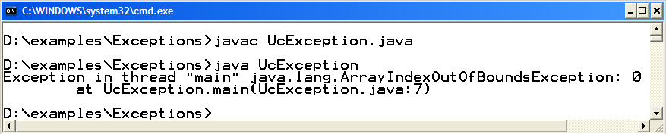
Example: Unchecked Exceptions compile & execute

Slide 25
Example: Unchecked Exceptions
public class UcException {
public static void main(String args[ ]) {
System.out.println(args[0]);
}
}

Slide 26
Example: Unchecked Exceptions
Modification
public class UcException {
public static void main(String args[ ]) {
try {
System.out.println(args[0]);
}catch (IndexOutOfBoundsException ex) {
System.out.println(“You forget to pass command line argument”);
}
}
}

Slide 27
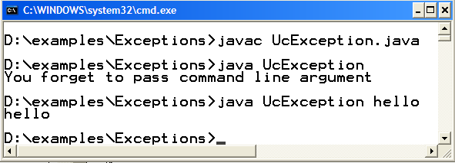
Example: Unchecked Exceptions compile & execute

Slide 28
Example: Checked Exceptions
import java.io.*;
public class CException {
public static void main(String args[ ]) {
FileReader fr = new FileReader (“input.txt”);
BufferedReader br = new BufferedReader(fr);
//read the line
String s = br.readLine();
System.out.println(s);
}
}

Slide 29
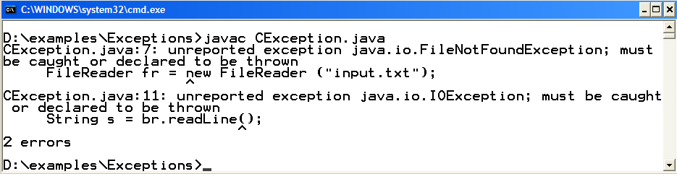
Example: Checked Exceptions compile & execute

Slide 30
Example: Checked Exceptions
Modification
import java.io.*;
public class CException {
public static void main(String args[ ]) {
try {
FileReader fr = new FileReader (“input.txt”);
BufferedReader br = new BufferedReader(fr);
//read the line
String s = br.readLine();
System.out.println(s);
} catch (IOException ex ) {
System.out.println(ex);
}
}
}

Slide 31
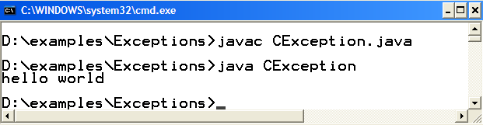
Example: Checked Exceptions compile & execute

Slide 32
Example: finally block
import java.io.*;
public class FBlockDemo {
public static void main(String args[ ]) {
try {
FileReader fr = new FileReader (“numbers.txt”);
BufferedReader br = new BufferedReader(fr);
String s = br.readLine();
System.out.println(s);
}catch (IOException ioEx) {
System.out.println(ioEx);
} finally {
System.out.println(“finally block always execute”);
//write any clean up code if required
}
}//end of main
}//end of class

Slide 33
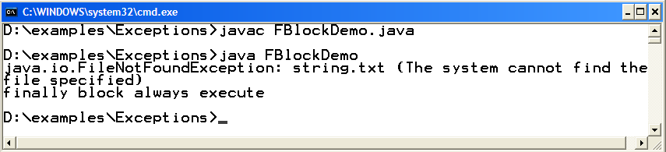
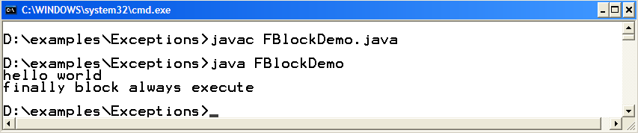
Compile & Execute
If “string.txt” isn’t there, it will throw FileNotFoundException
Note that finally block executes
If “string.txt” exist, hopefully no exception would be thrown
Note that finally block still executes

Slide 34
Multiple Catch Blocks
Possible to have multiple catch clauses for a single try statement
[
  Essentially checking for different types of exceptions that may happen
Evaluated in the order of the code
  Bear in mind the Exception hierarchy when writing multiple catch clauses!
  If you catch Exception first and then IOException, the IOException will never be caught!

Slide 35
Example: Multiple catch blocks
/* numbers.txt contains numbers. After reading number
from file, prints its square on console */
import java.io.*;
public class MCatchDemo {
public static void main(String args[ ]) {
try {
//may throw FileNotFound & IOException
FileReader fr = new FileReader (“numbers.txt”);
BufferedReader br = new BufferedReader(fr);
//read the line
String s = br.readLine();
//may throw NumberFormatException, if s is not no.
int number = Integer.parseInt(s);
System.out.println(number * number);

Slide 36
Example: Multiple catch blocks
} catch (NumberFormatException nfEx ) {
System.out.println(nfEx);
} catch (FileNotFoundException fnfEx) {
System.out.println(fnfEx);
} catch (IOException ioEx) {
System.out.println(ioEx);
}
}
}

Slide 37
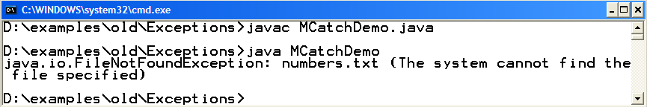
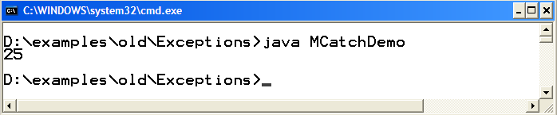
Compile & Execute
If “numbers.txt” isn’t there, it will throw FileNotFoundException
If “numbers.txt” exist and contains a number, Hopefully no exception would be occurred

Slide 38
printStackTrace() is your friend!
When dealing with exceptions
Especially when debugging
printStackTrace() will:
  Show you the full calling history
  With line numbers
Note:
  Bad idea to eat an exception silently!
  Either printStackTrace() or pass it along to be handled at a different level

Slide 39
The throws clause

Slide 40
The throws clause
Method doesn’t want to handle exception itself
it throws the exception, the caller should handle this exception or throws the exception itself
A method should specify the exceptions it throws by placing a throws clause after the parameter list

Slide 41
What if
  Method throws back the exception
  No catch blocks matches
  Exception is not handled
calls main
calls method1
calls method2
Java
runtime
system
main
method
method2
method1
exception
if not caught
or
throws back
if not caught
or
throws back
if not caught
or
throws back

Slide 42
Example: throws clause
// this example shows the use of throws clasuse and printStackTrace() method
import java.io.*;
public class ThrowsDemo {
//method used to read line from file
public static void method2 () {
try {
FileReader fr = new FileReader(“string.txt”);
BufferedReader br = new BufferedReader(fr);
String s = br.readLine();
System.out.println(s);
}catch (IOException ioEx) {
ioEx.printStackTrace();
}
} //end of method

Slide 43
Example: throws clause
// used to call method1
public static void method1 () {
method2();
}
public static void main(String args[]){
ThrowsDemo.method1();
}
}//end of class

Slide 44
Example: throws clause
Method2 doesn’t want to handle exception itself, so it
throws the exception to the caller
So method2 modified as
…..
public static void method2 () throws IOException {
FileReader fr = new FileReader();
BufferedReader br = new BufferedReader(fr);
String s = br.readLine();
System.out.println(s);
} //end of method
…….

Slide 45
Example: throws clause
As method2 is throwing the exception & method1 is invoking method 2
So method1 either can handles the coming exception or rethrows it
If method1 is handling the exception then method1 would be modified as
// used to call method1
public static void method1 () {
try {
method2();
catch (IOException ioEx) {
ioEx.printStackTrace();
}
}
public static void main(String args[]){
ThrowsDemo.method1();
}
}//end of class

Slide 46
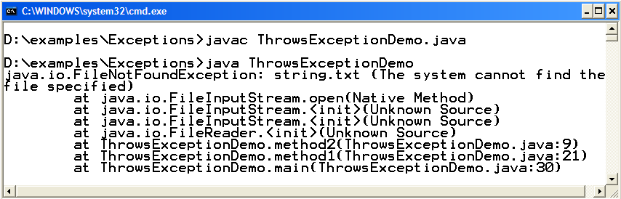
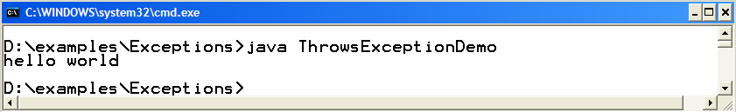
Compile & Execute
If “string.txt” isn’t there, it will throw FileNotFoundException
If “string.txt” exist there and contains string

Slide 47
Defining Exception Classes
A throw statement can throw an exception object of any exception class
Instead of using a predefined class, exception classes can be programmer-defined
  These can be tailored to carry the precise kinds of information needed in the catch block
  A different type of exception can be defined to identify each different exceptional situation
Copyright © 2012 Pearson Addison-Wesley. All rights reserved.

Slide 48
Defining Exception Classes
Every exception class to be defined must be a derived class of some already defined exception class
  It can be a derived class of any exception class in the standard Java libraries, or of any programmer defined exception class
Constructors are the most important members to define in an exception class
  They must behave appropriately with respect to the variables and methods inherited from the base class
  Often, there are no other members, except those inherited from the base class
The following exception class performs these basic tasks only
Copyright © 2012 Pearson Addison-Wesley. All rights reserved.

Slide 49
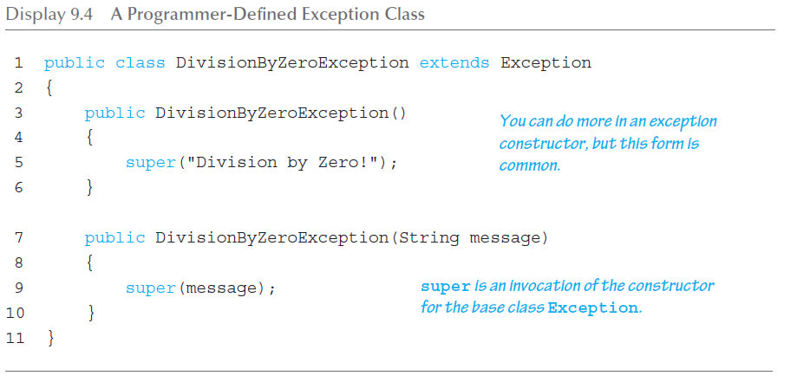
A Programmer-Defined Exception Class
Copyright © 2012 Pearson Addison-Wesley. All rights reserved.

Slide 50
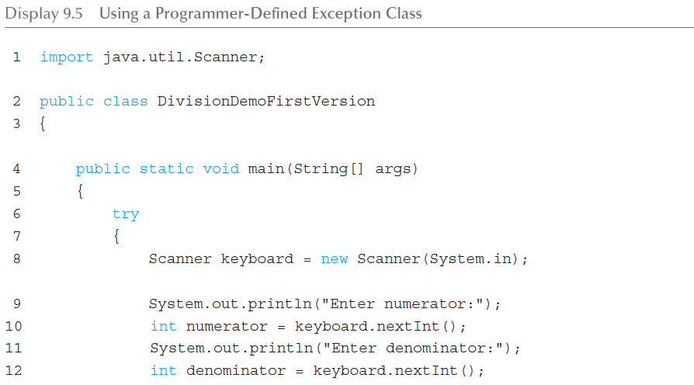
Using our own Exception Class (1 of 3)
Copyright © 2012 Pearson Addison-Wesley. All rights reserved.

Slide 51
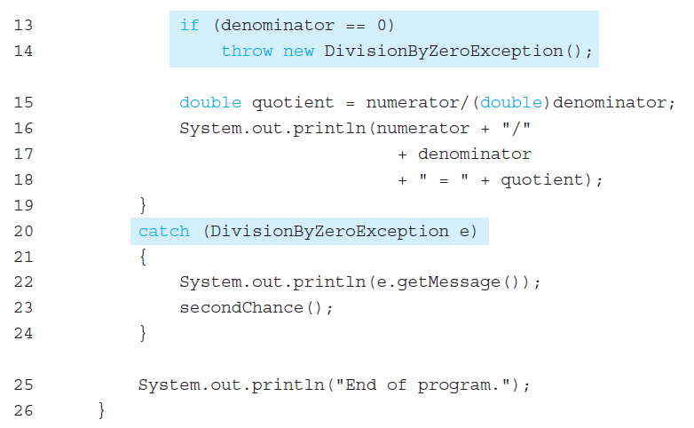
Using our own Exception Class (2 of 3)
Copyright © 2012 Pearson Addison-Wesley. All rights reserved.

Slide 52
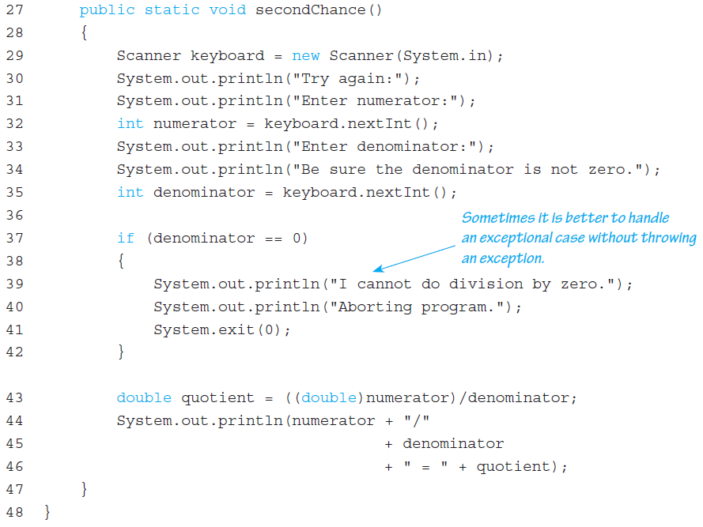
Using our own Exception Class (3 of 3)
Copyright © 2012 Pearson Addison-Wesley. All rights reserved.

Slide 53
Tip: An Exception Class Can Carry a Message of Any Type: int Message
An exception class constructor can be defined that takes an argument of another type
  It would stores its value in an instance variable
  It would need to define accessor methods for this instance variable
Copyright © 2012 Pearson Addison-Wesley. All rights reserved.

Slide 54
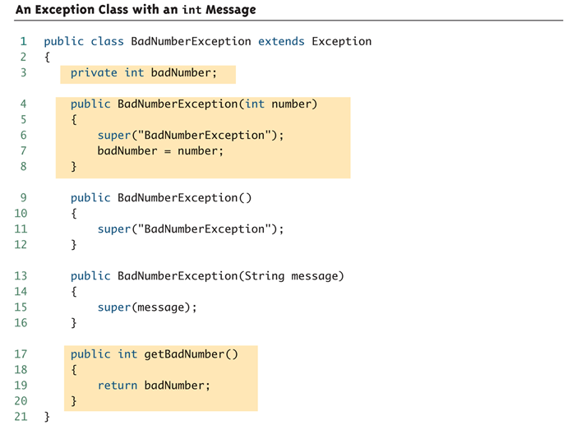
An Exception Class with an int Message
Copyright © 2012 Pearson Addison-Wesley. All rights reserved.

